Slide 1
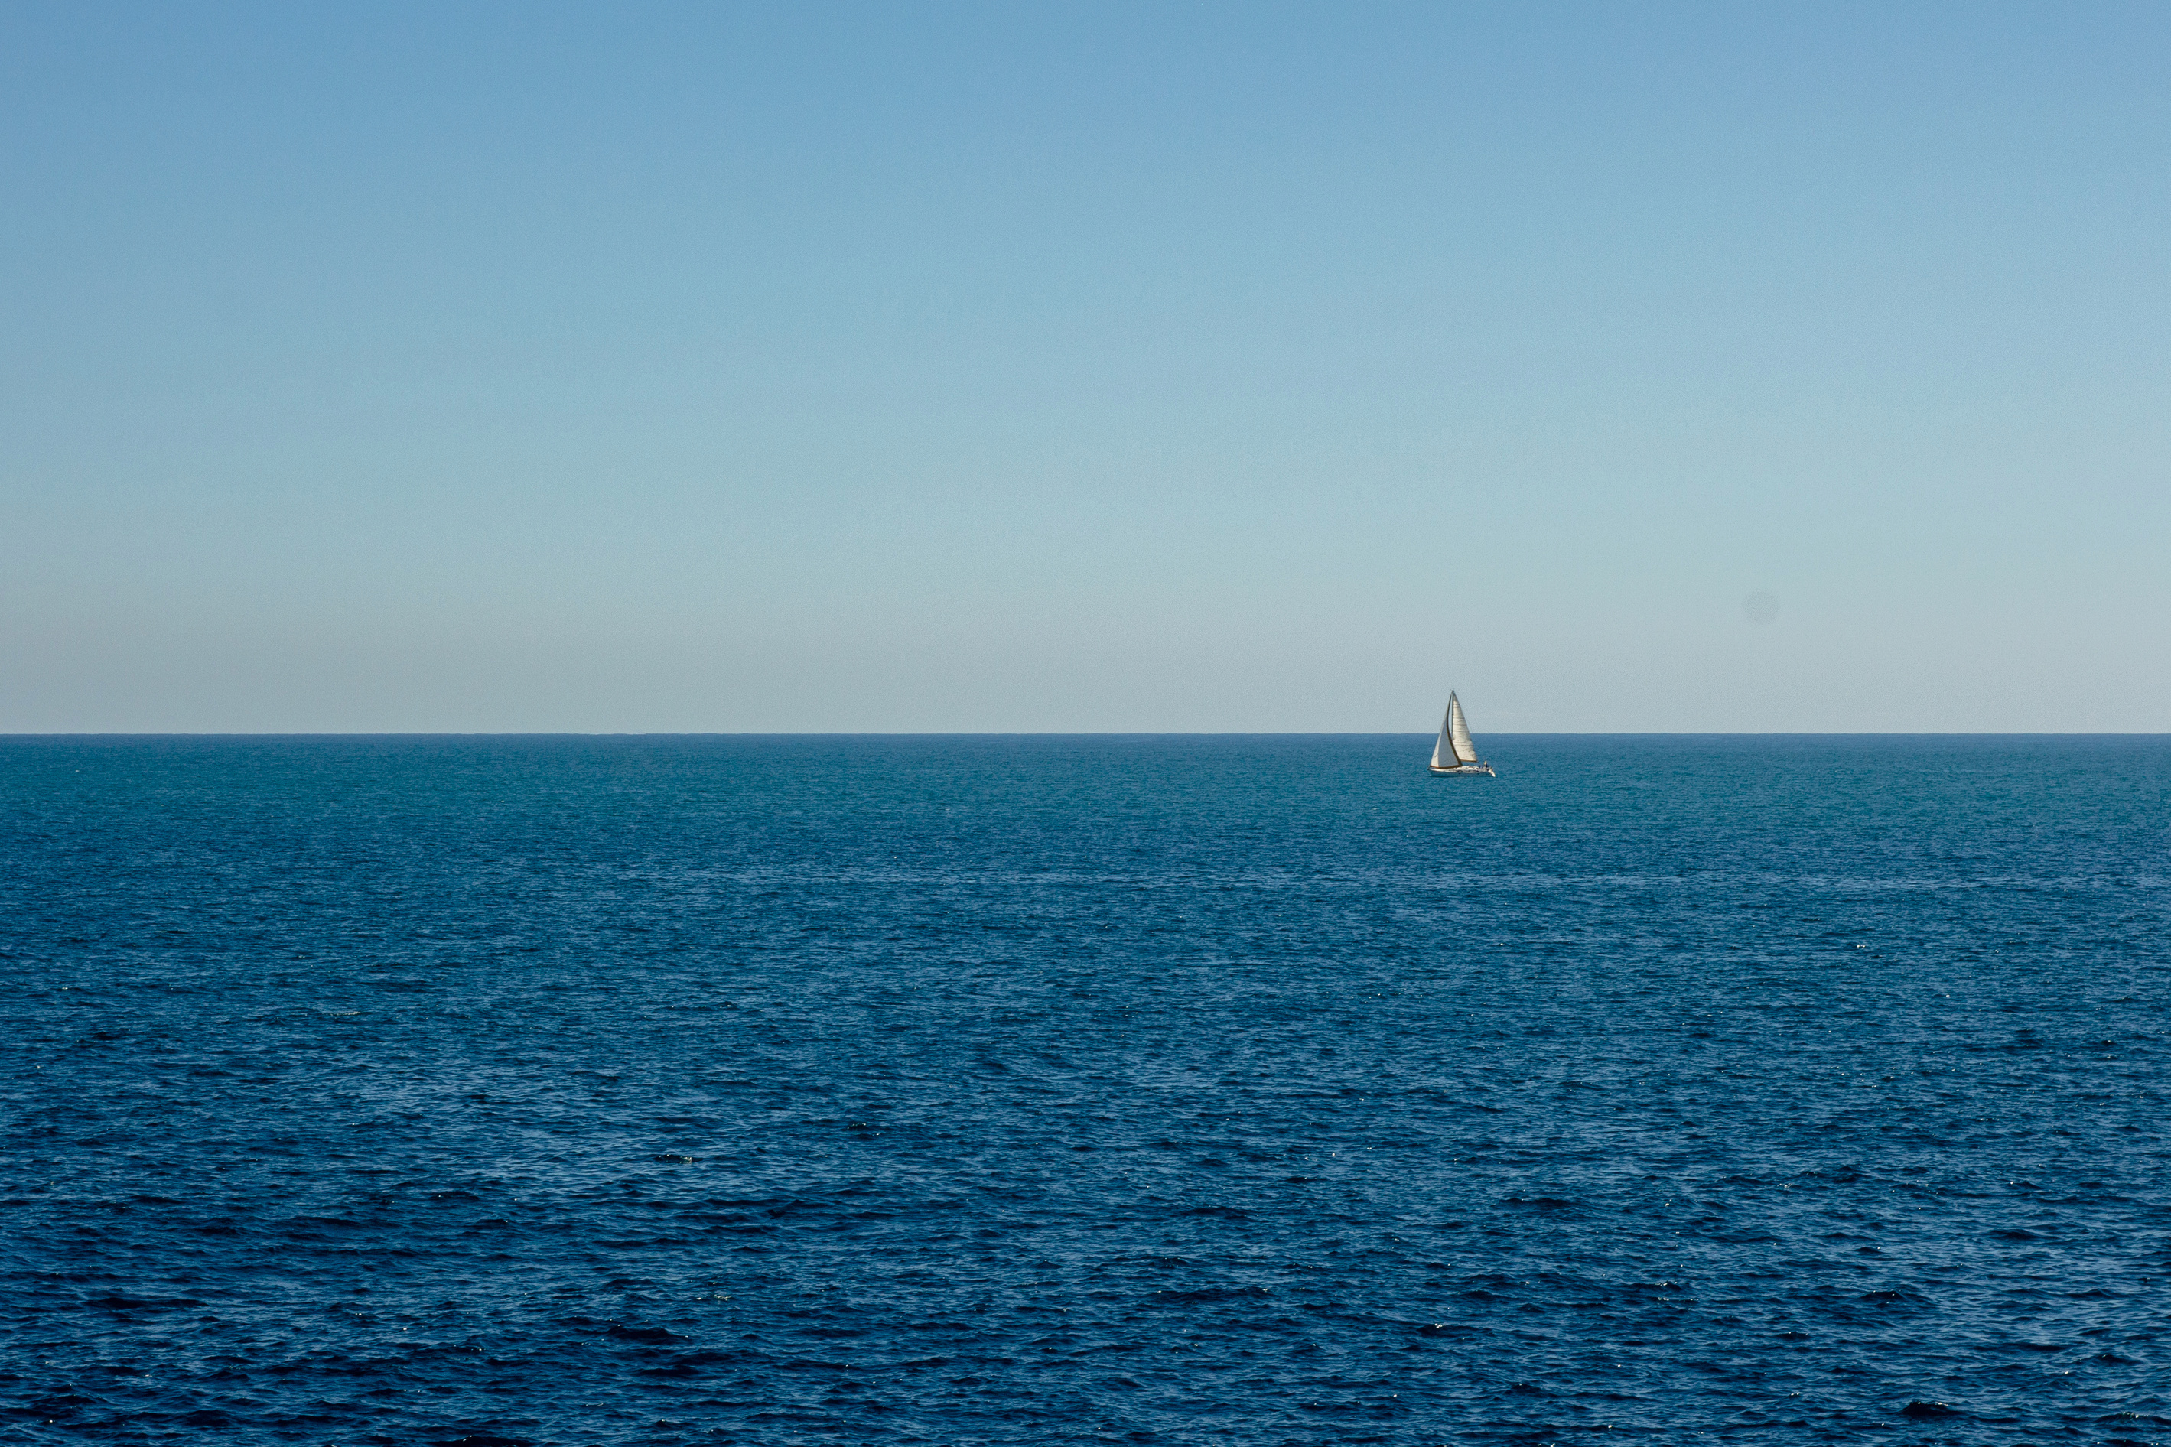




AN UNDERWATER DOCKING SYSTEM
FOR SUSTAINED PRESENCE AT SEA
Author:
AMBRA IERARDI
Supervisors:
ANTONIO PASCOAL
ENRICO SIMETTI
OLIVIER KERMORGANT

Slide 2
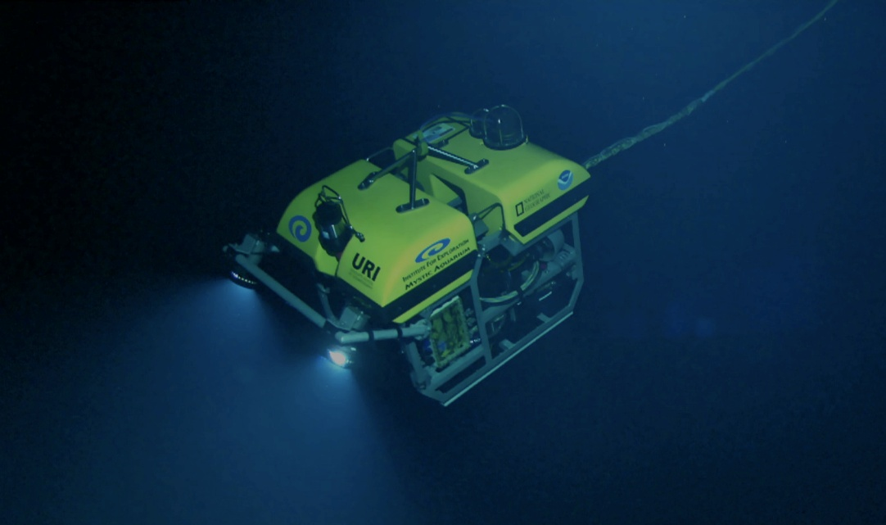
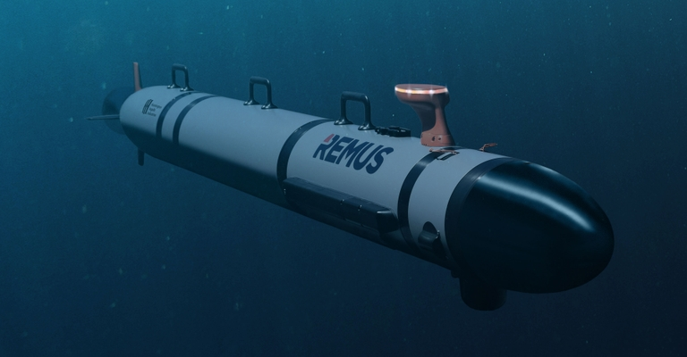
CONTEXT
The oceans cover more than 70% of the Earth’s surface
Over 80% of the seabed has not yet been mapped
HII REMUS 600M AUV
by WHOI
AUVs vs ROVs
Little Hercules ROV
by NOAA and URI
2
Notes:
NOAA = National Oceanic and Atmospheric Administration ----- URI = University of Rhode Island ----- WHOI = Woods Hole Oceanographic Institution

Slide 3
AUV PROBLEMS
Launch and recovery
Battery life
Data communication
SOLUTION
Docking systems
Static
In motion
3

Slide 4
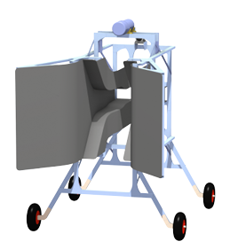
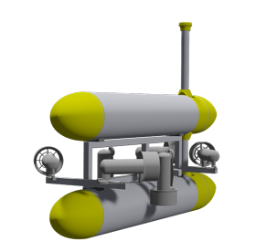
VEHICLE and DOCKING STATION
CAD model of the MEDUSA vehicle
CAD model of the MEDUSA custom Docking Station
Docking Station localization issue
Recharge AUV batteries
Navigation among currents and uncertainty
Data transfer

Slide 5
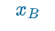
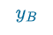
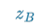

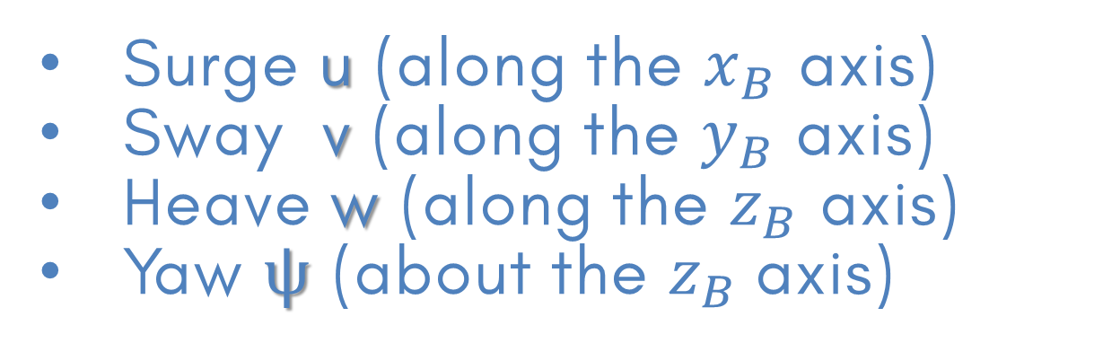
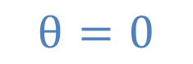

4 Degrees-of-Freedom
VEHICLE SETTINGS
Surge u (along the $x_{B}$ axis)
Sway v (along the $y_{B}$ axis)
Heave w (along the $z_{B}$ axis)
Yaw $ψ$ (about the $z_{B}$axis)
Body Frame
Facing
with
Unknown constant ocean current
Process noise
$$θ=0$$
$$Φ=0$$
5

Slide 6

4-PHASES GUIDANCE
SHIP
Ship-based navigation
1
Beacon-based navigation
Straight trajectory
2a
Circular trajectory
Blended circular and straight-line homing
2b
DS
2c

Slide 7


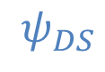

QUANTITY
CASE
$$P_{DS}$$
$$ψ_{DS}$$
DOCKING STATION KNOWLEDGE
CASES
1
2
3
KNOWN
NOT KNOWN
7

Slide 8
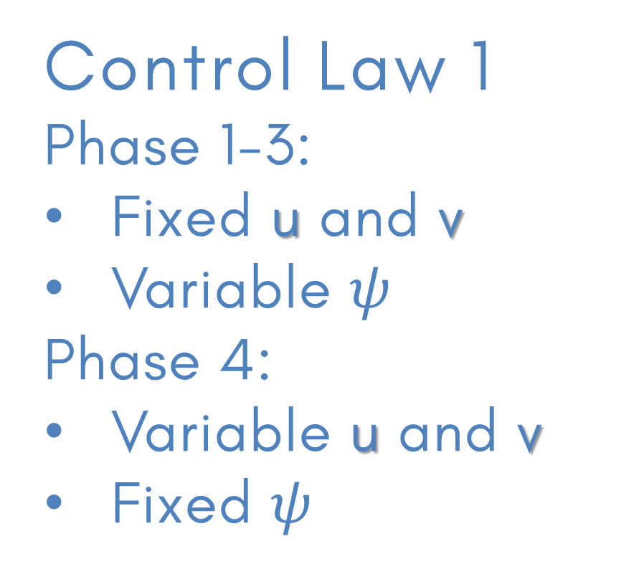
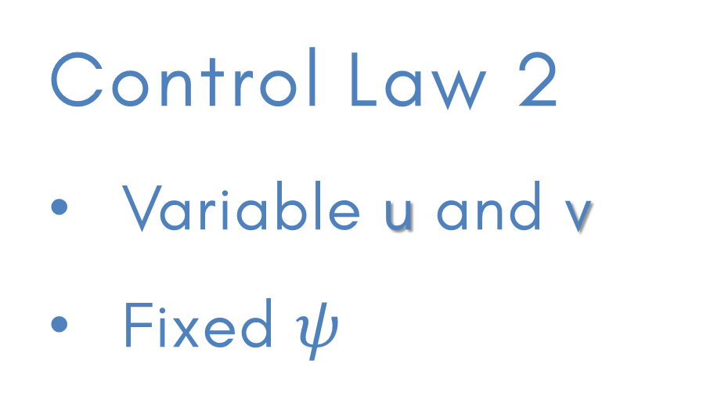
EXAMINED VEHICLE SETTINGS
Control Law 1
Phase 1-3:
Fixed u and v
Variable $ψ$
Phase 4:
Variable u and v
Fixed $ψ$
Control Law 2
Variable u and v
Fixed $ψ$
Suitable for cases 1-3
Suitable for case 2 only
Notes:
Heave dillo solo a voce tanto è tutto uguale

Slide 9
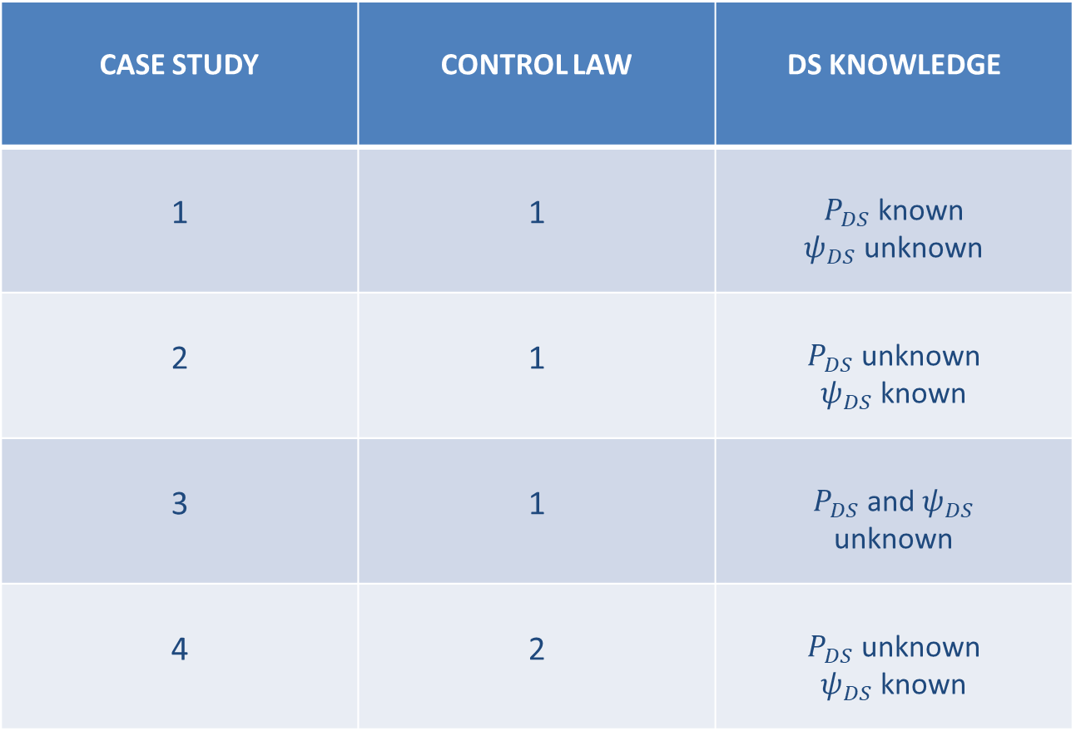
4 CASE STUDIES
CASE STUDY | CONTROL LAW | DS KNOWLEDGE
1 | 1 | $P_{DS}$ known $ψ_{DS}$ unknown
2 | 1 | $P_{DS}$ unknown $ψ_{DS}$ known
3 | 1 | $P_{DS}$ and $ψ_{DS}$ unknown
4 | 2 | $P_{DS}$ unknown $ψ_{DS}$ known
Notes:
Heave dillo solo a voce tanto è tutto uguale

Slide 10


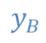


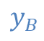





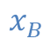

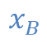
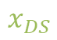
$$ψ_{r}$$
$$y_{B}$$
$$x_{B}$$
$$ψ_{r}≜ψ_{DS}−ψ_{AUV}$$
Right transponder
$$ψ_{meas}$$
$$x_{DS}$$
$$y_{DS}$$
$$x_{DS}$$
RELATIVE ORIENTATION $ψ_{r}$
$$y_{DS}$$
$$.^{DS}ΔP$$
Left transponder
$$x_{B}$$
$$y_{B}$$
2 transponders on the DS
1 inverted USBL on the AUV only
Less expensive
10

Slide 11
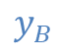



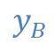



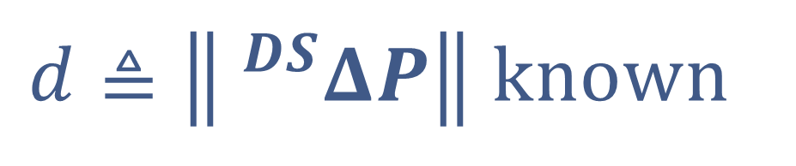


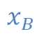
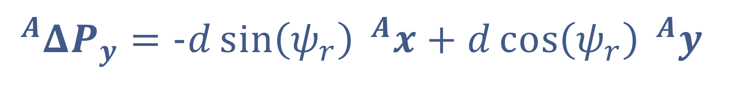
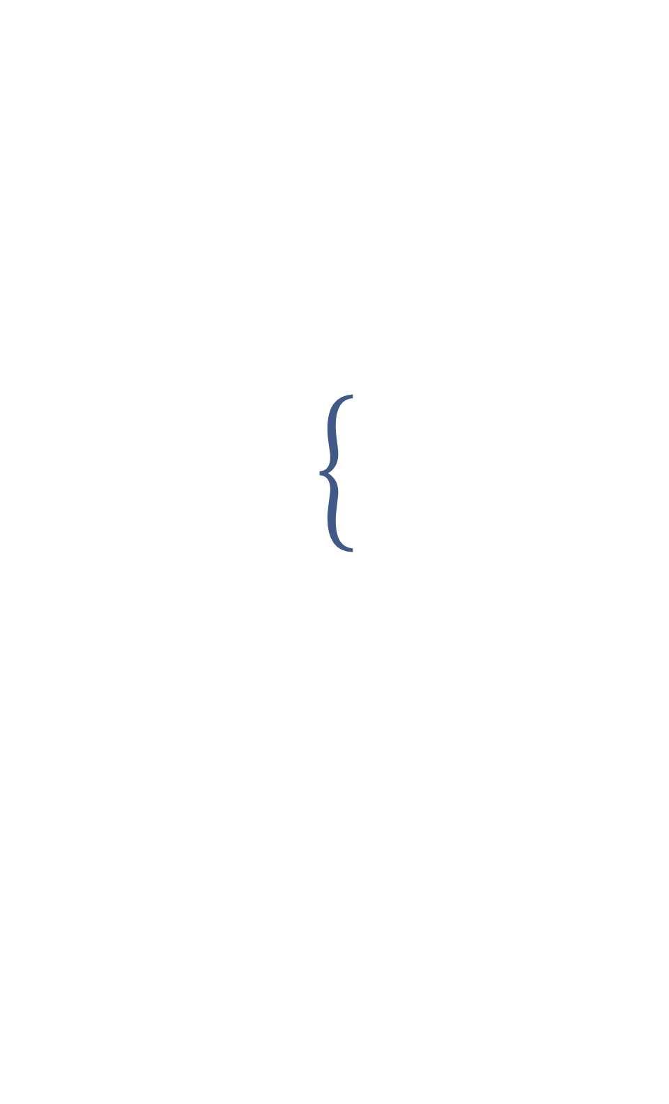
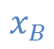
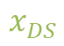

$$ψ_{r}$$
$$y_{B}$$
$$x_{B}$$
Right transponder
$$ψ_{meas}$$
RELATIVE ORIENTATION $ψ_{r}$
$$x_{DS}$$
$$y_{DS}$$
$$x_{DS}$$
$$y_{DS}$$
$$.^{DS}ΔP$$
Left transponder
$$x_{B}$$
$$y_{B}$$
$^{DS}ΔP≜$ ${{}_{ }^{DS}P}_{R}−^{DS}P_{L}$
$$^{A}ΔP_{x}=d\cos\left(ψ_{r}\right) ^{A}x+d\sin\left(ψ_{r}\right) ^{A}y$$
$$^{A}ΔP_{y}=−d\sin\left(ψ_{r}\right) ^{A}x+d\cos\left(ψ_{r}\right) ^{A}y$$
Observed quantity
$$d≜\left\| ^{DS}ΔP\right\| known$$

Slide 12

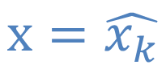


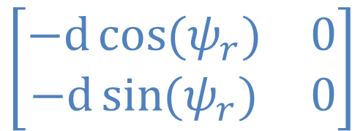

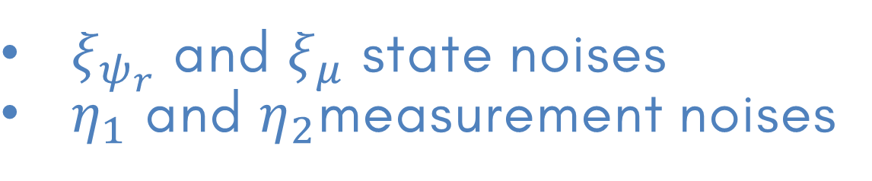

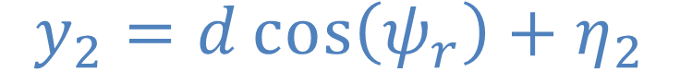

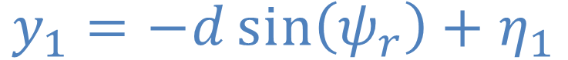

$ψ_{r}$ ESTIMATION
Angle $ψ_{r}$ and gyroscope bias $μ$ estimator
Extended Kalman Filter
$$\dot{ψ_{r}}=r_{m}+μ+ξ_{ψ_{r}}$$
$ξ_{ψ_{r}}$ and $ξ_{μ}$ state noises
$η_{1}$ and $η_{2}$measurement noises
$$\dot{μ}=ξ_{μ}$$
Observations
$$y_{1}=−d\sin\left(ψ_{r}\right)+η_{1}$$
$$\left[\begin{matrix}−d\cos{(ψ_{r})} & 0 \\ −d\sin{(ψ_{r})} & 0\end{matrix}\right]$$
$$H_{K}=$$
$$y_{2}=d\cos\left(ψ_{r}\right)+η_{2}$$
$$x=\hat{x_{k}}$$
12

Slide 13
SIMULATION ENVIRONMENT
Custom made Simulink environment
Reusable for different vehicles
Light-weight simulator
Sensors’ simulator
Trajectory visualization
Errors visualization
Notes:
Numeric -> lighter

Slide 14

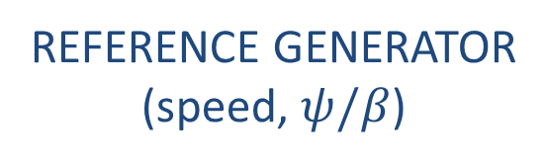
SIMULATION & CONTROL SCHEME
GUIDANCE, NAVIGATION, CONTROL
PHYSIC MODEL
(dynamics + kinematics)
CONTROLLERS
SENSORS SIMULATOR
STATE ESTIMATOR
REFERENCE GENERATOR
(speed, $ψ/β$)
SIMULATION MODEL

Slide 15
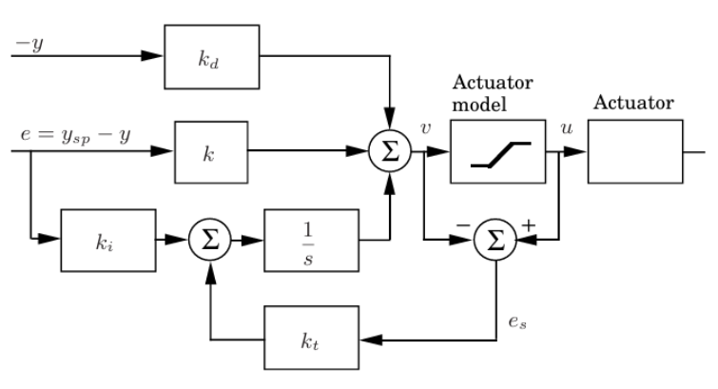
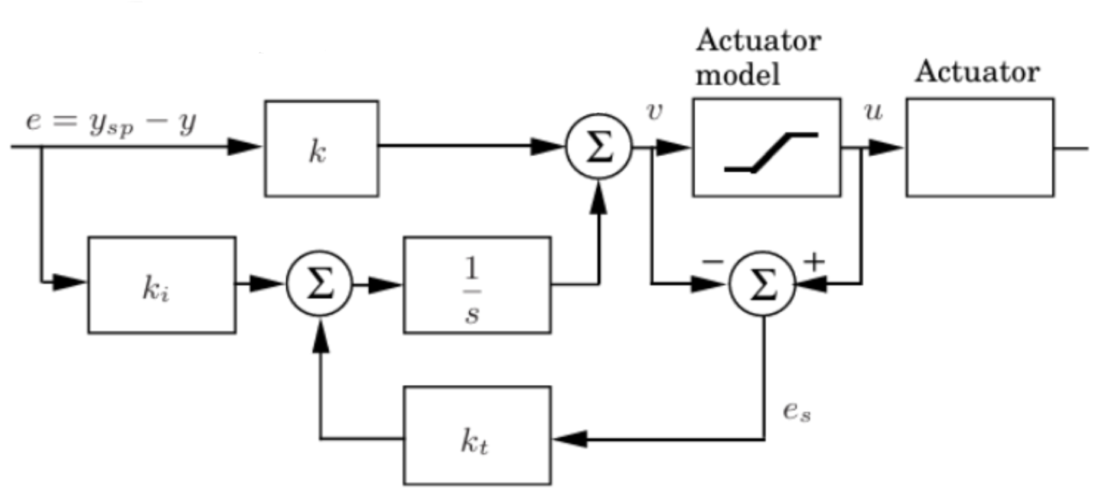
CONTROLLERS
PI with Anti Wind-Up
PID with Anti Wind-Up
Surge
Sway
Depth
Yaw
15
Notes:
Avoid integrator saturation to prevent longer response time on the error’s correction

Slide 16
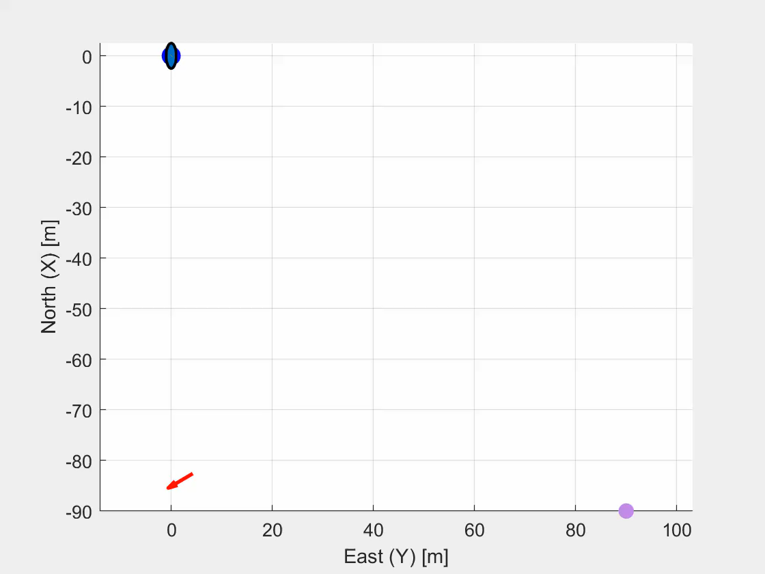
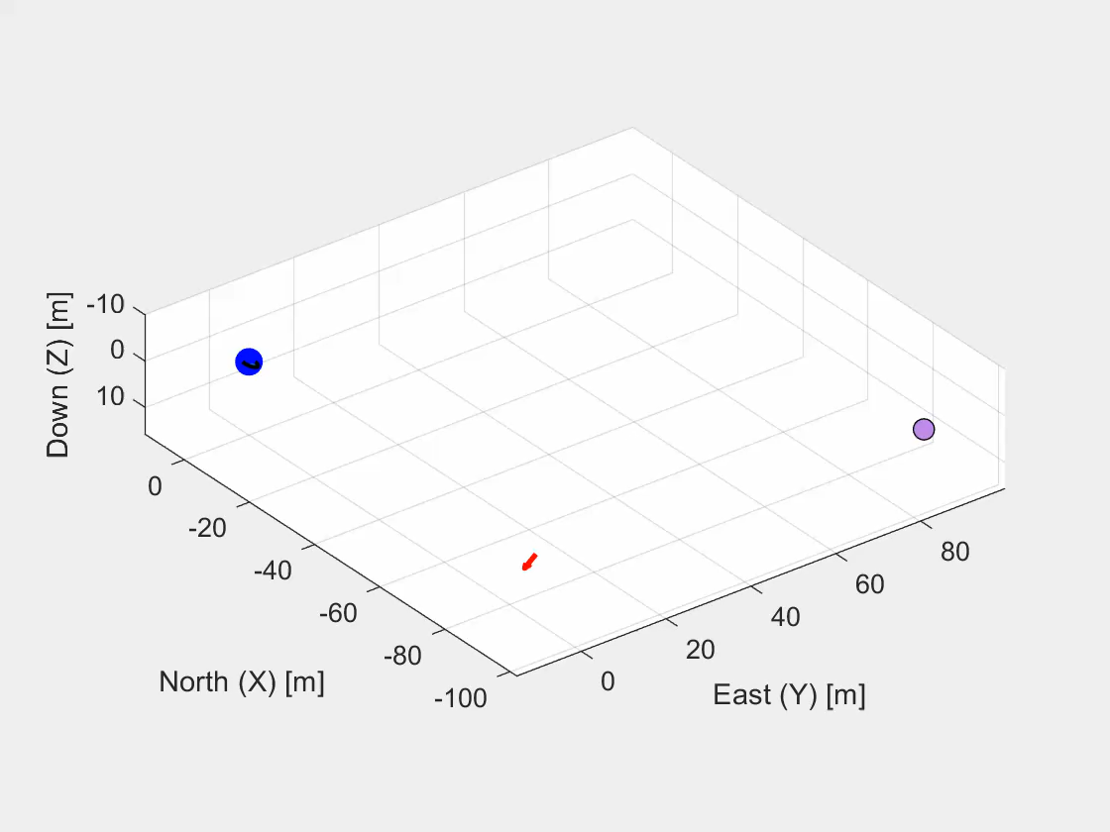


CASE STUDY 2
Variable $ψ$ – Fixed u, v
Known $ψ_{DS}$ – Unknown $P_{DS}$
2D view
3D view

Slide 17
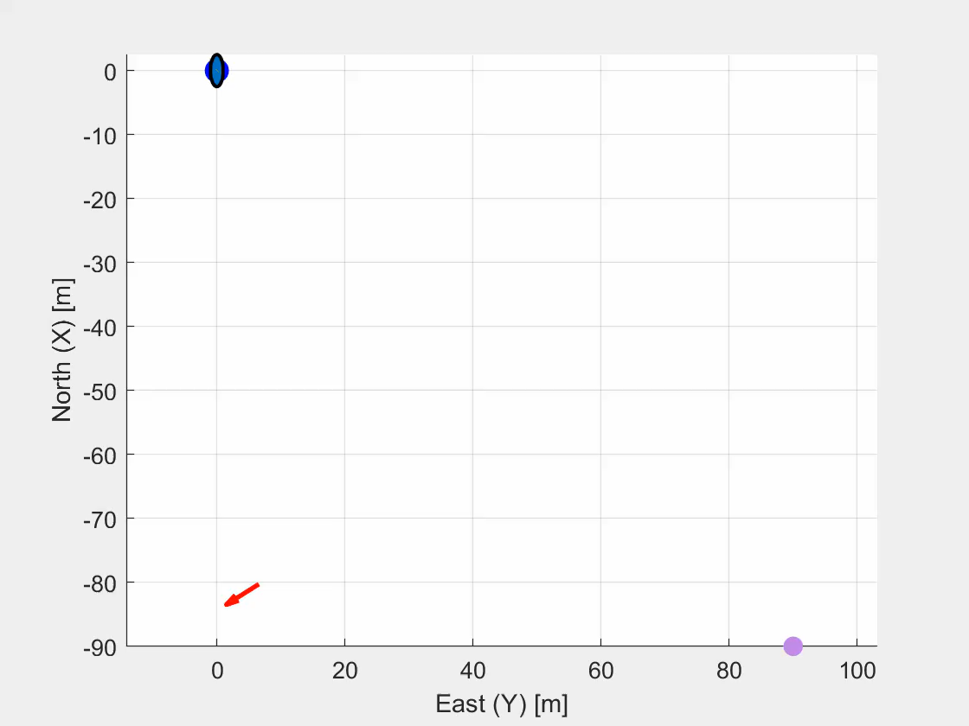
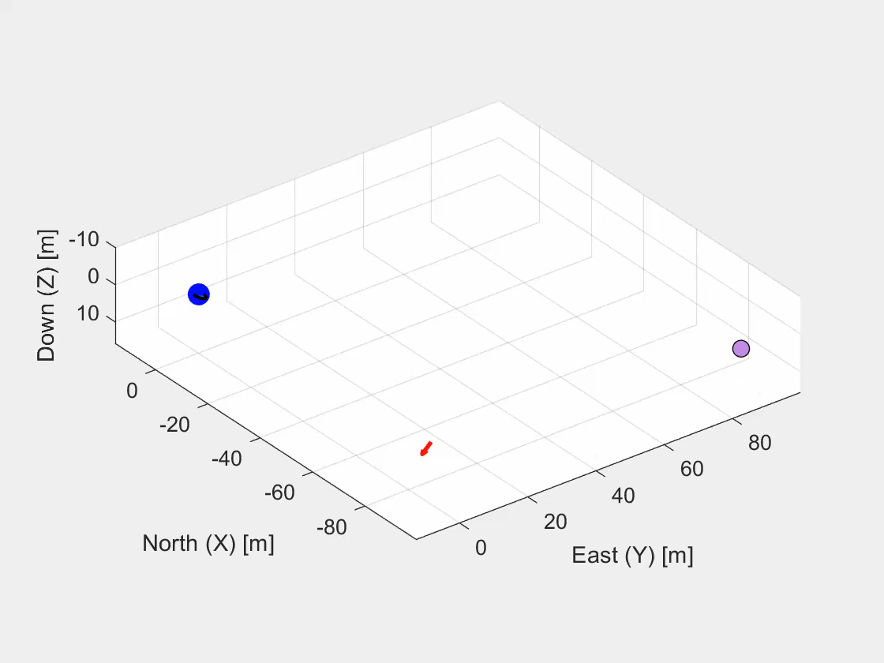

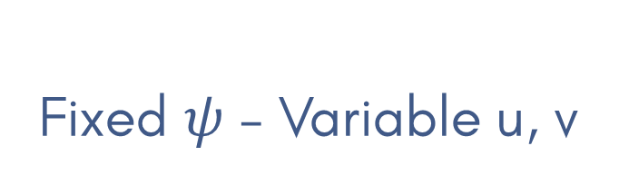
CASE STUDY 4
Fixed $ψ$ – Variable u, v
Known $ψ_{DS}$ – Unknown $P_{DS}$
2D view
3D view

Slide 18
MONTE CARLO METHOD
100 simulations for each case study
Behavior’s statistical description
Randomic number seed
18
Notes:
Pro and cons of AUV and ROV

Slide 19
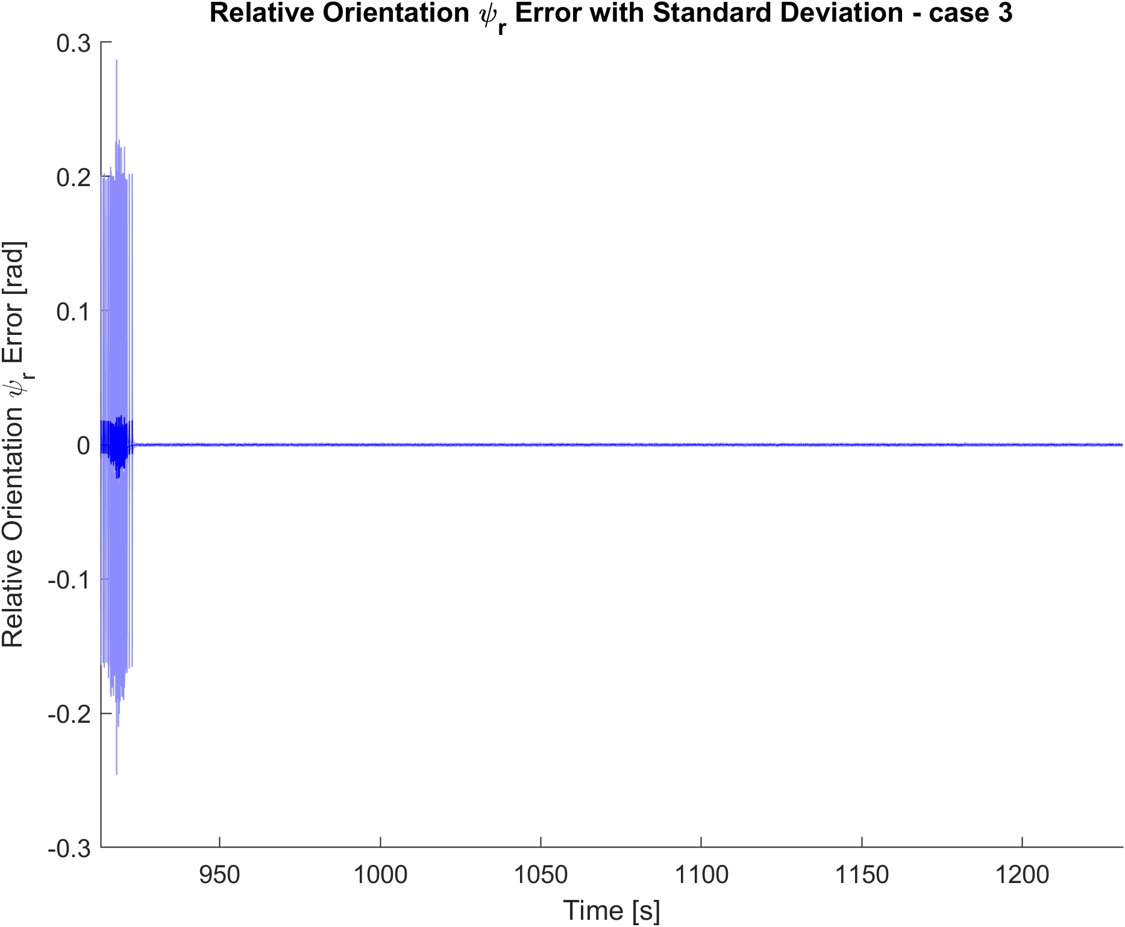
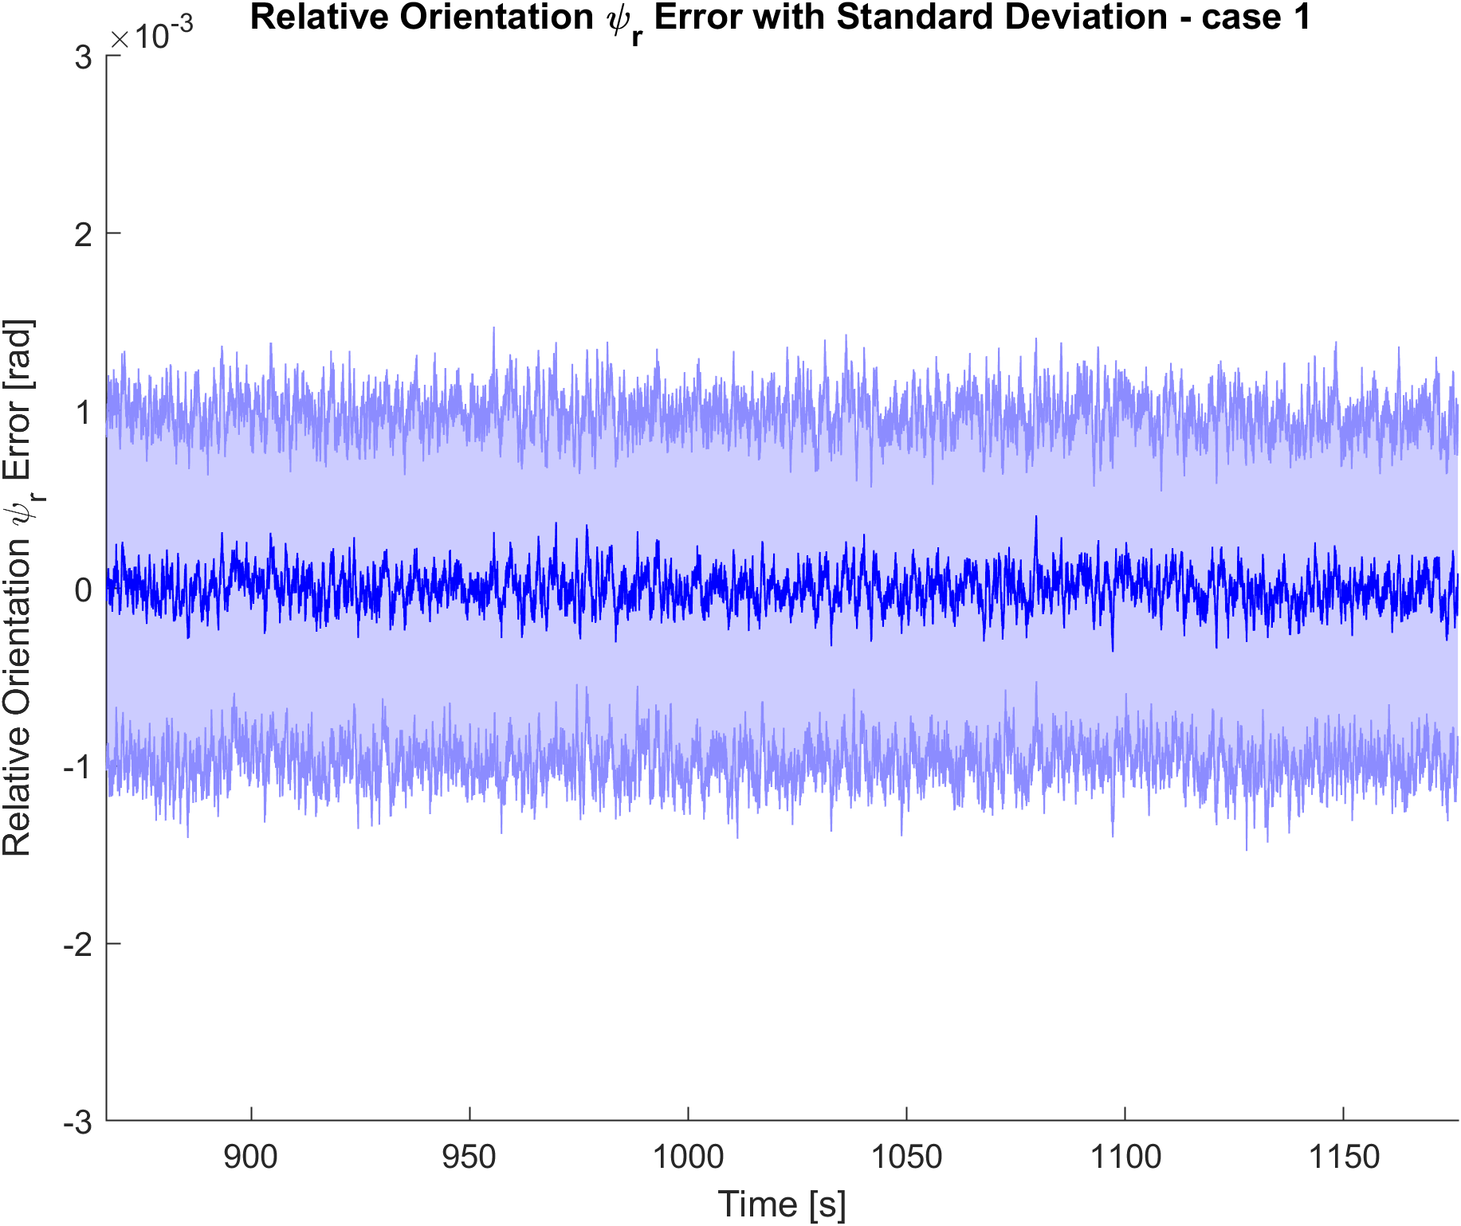
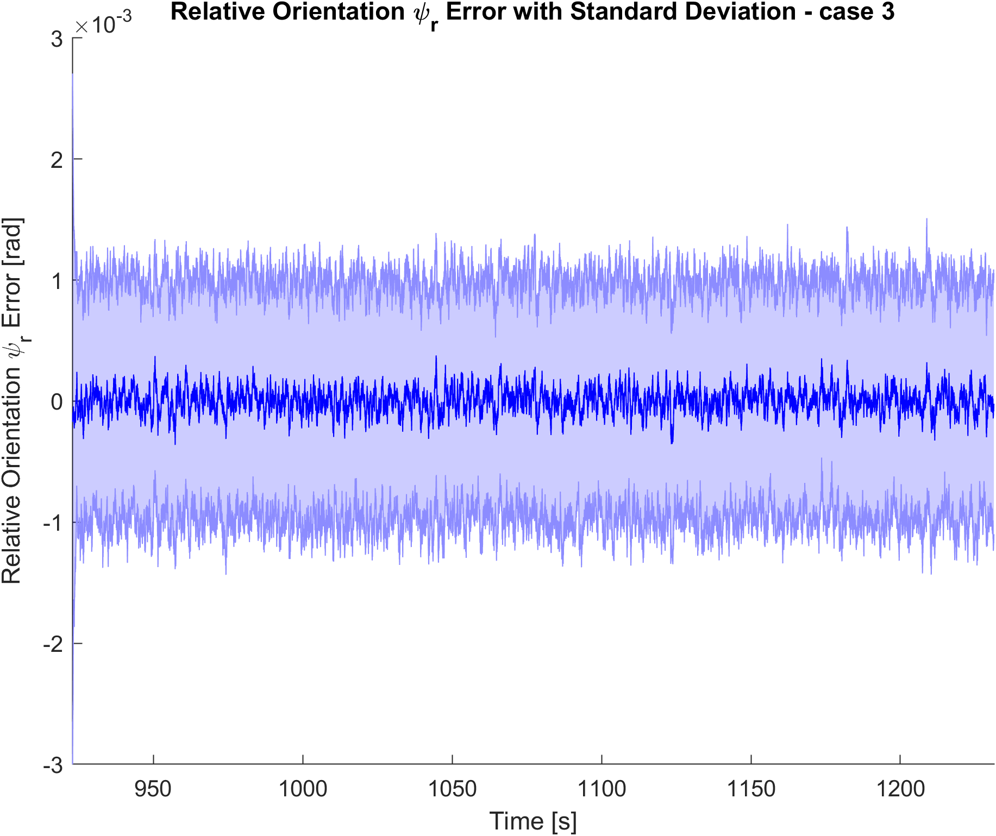
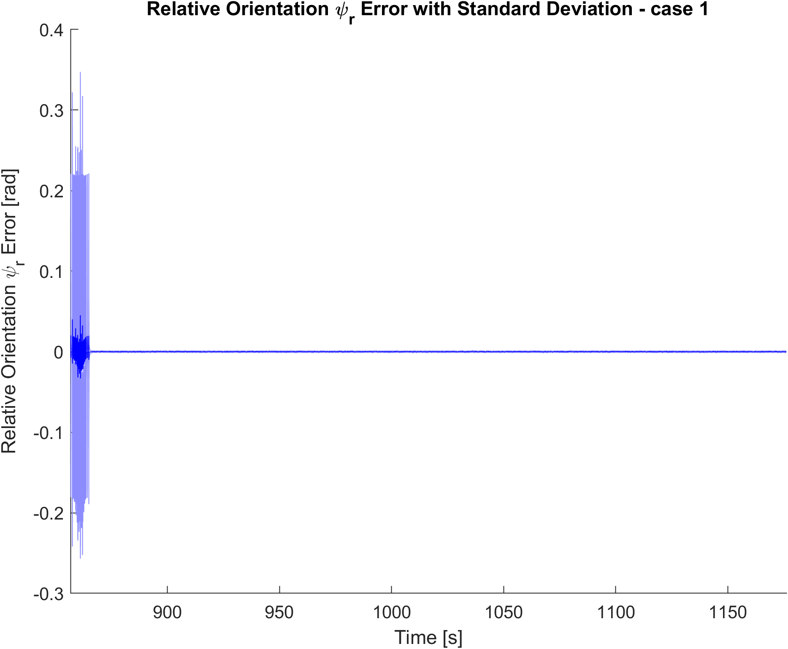

$ψ_{r}$ ESTIMATE ERROR
CASE STUDY 1
CASE STUDY 3

Slide 20
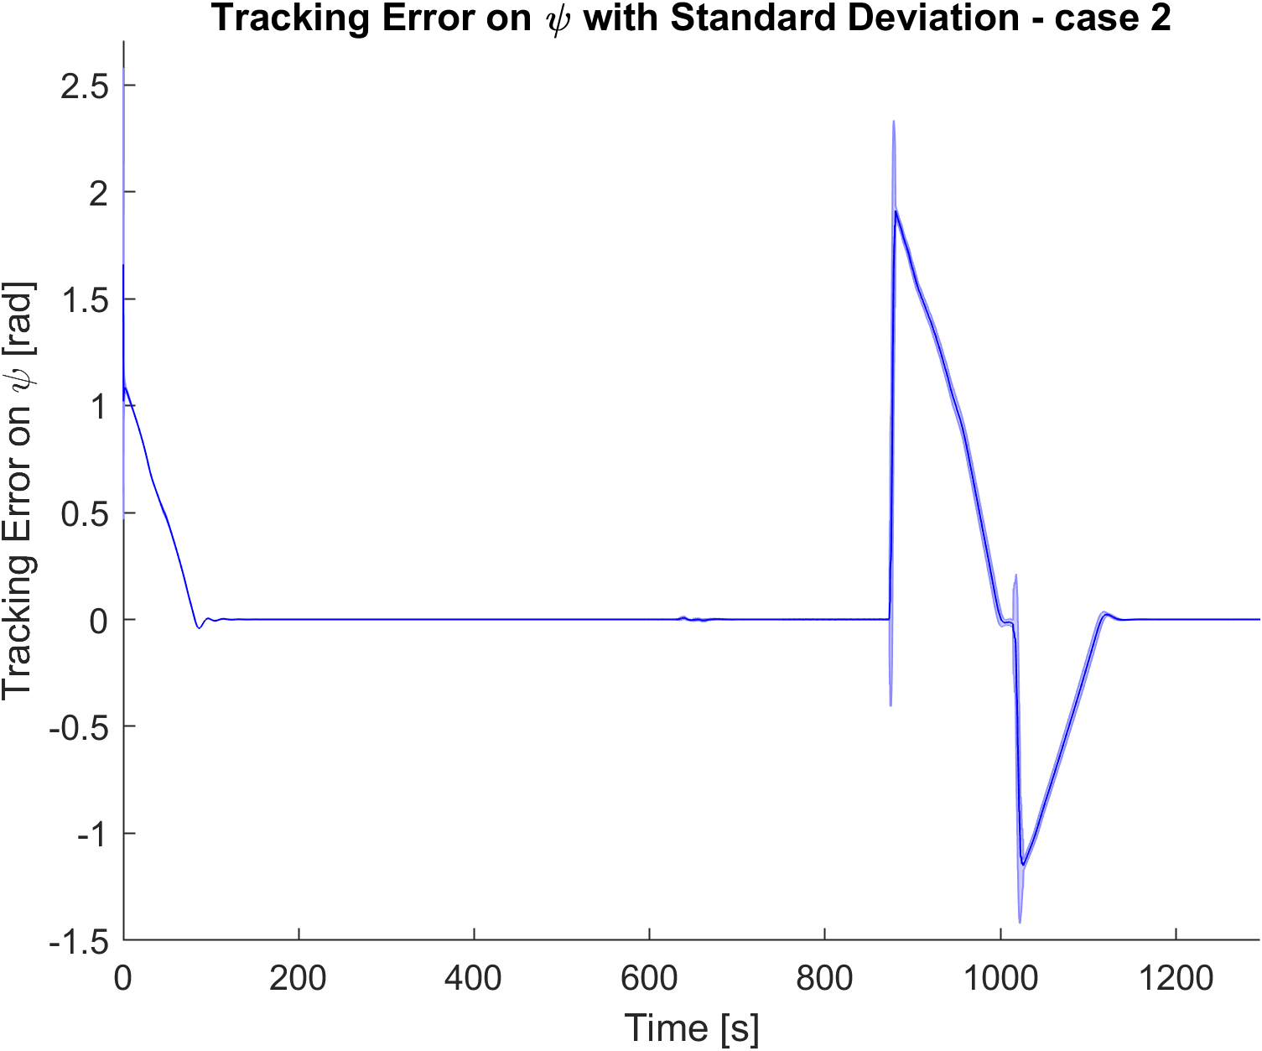
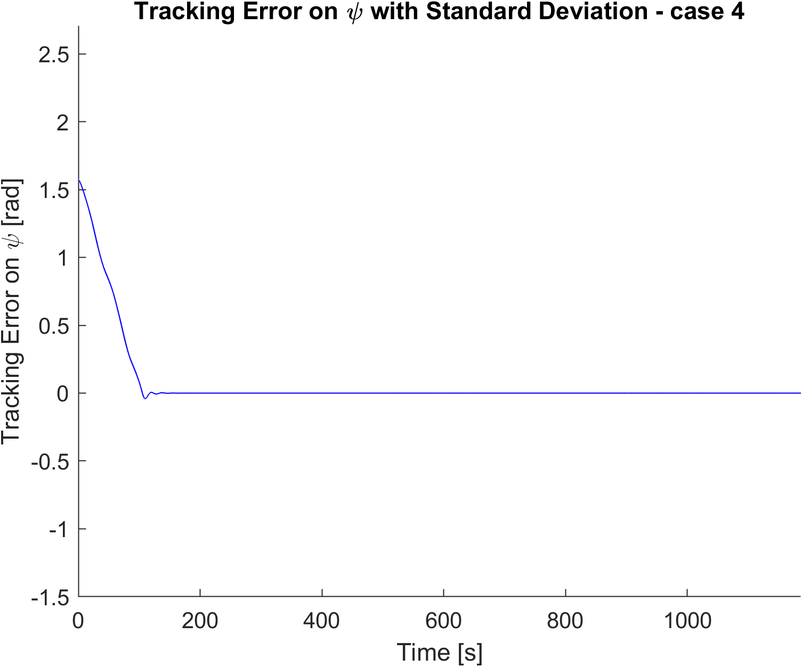
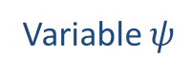

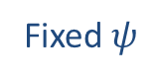
$ψ$ CONTROL ERROR
CASE STUDY 2
CASE STUDY 4
Variable $ψ$
Fixed $ψ$

Slide 21
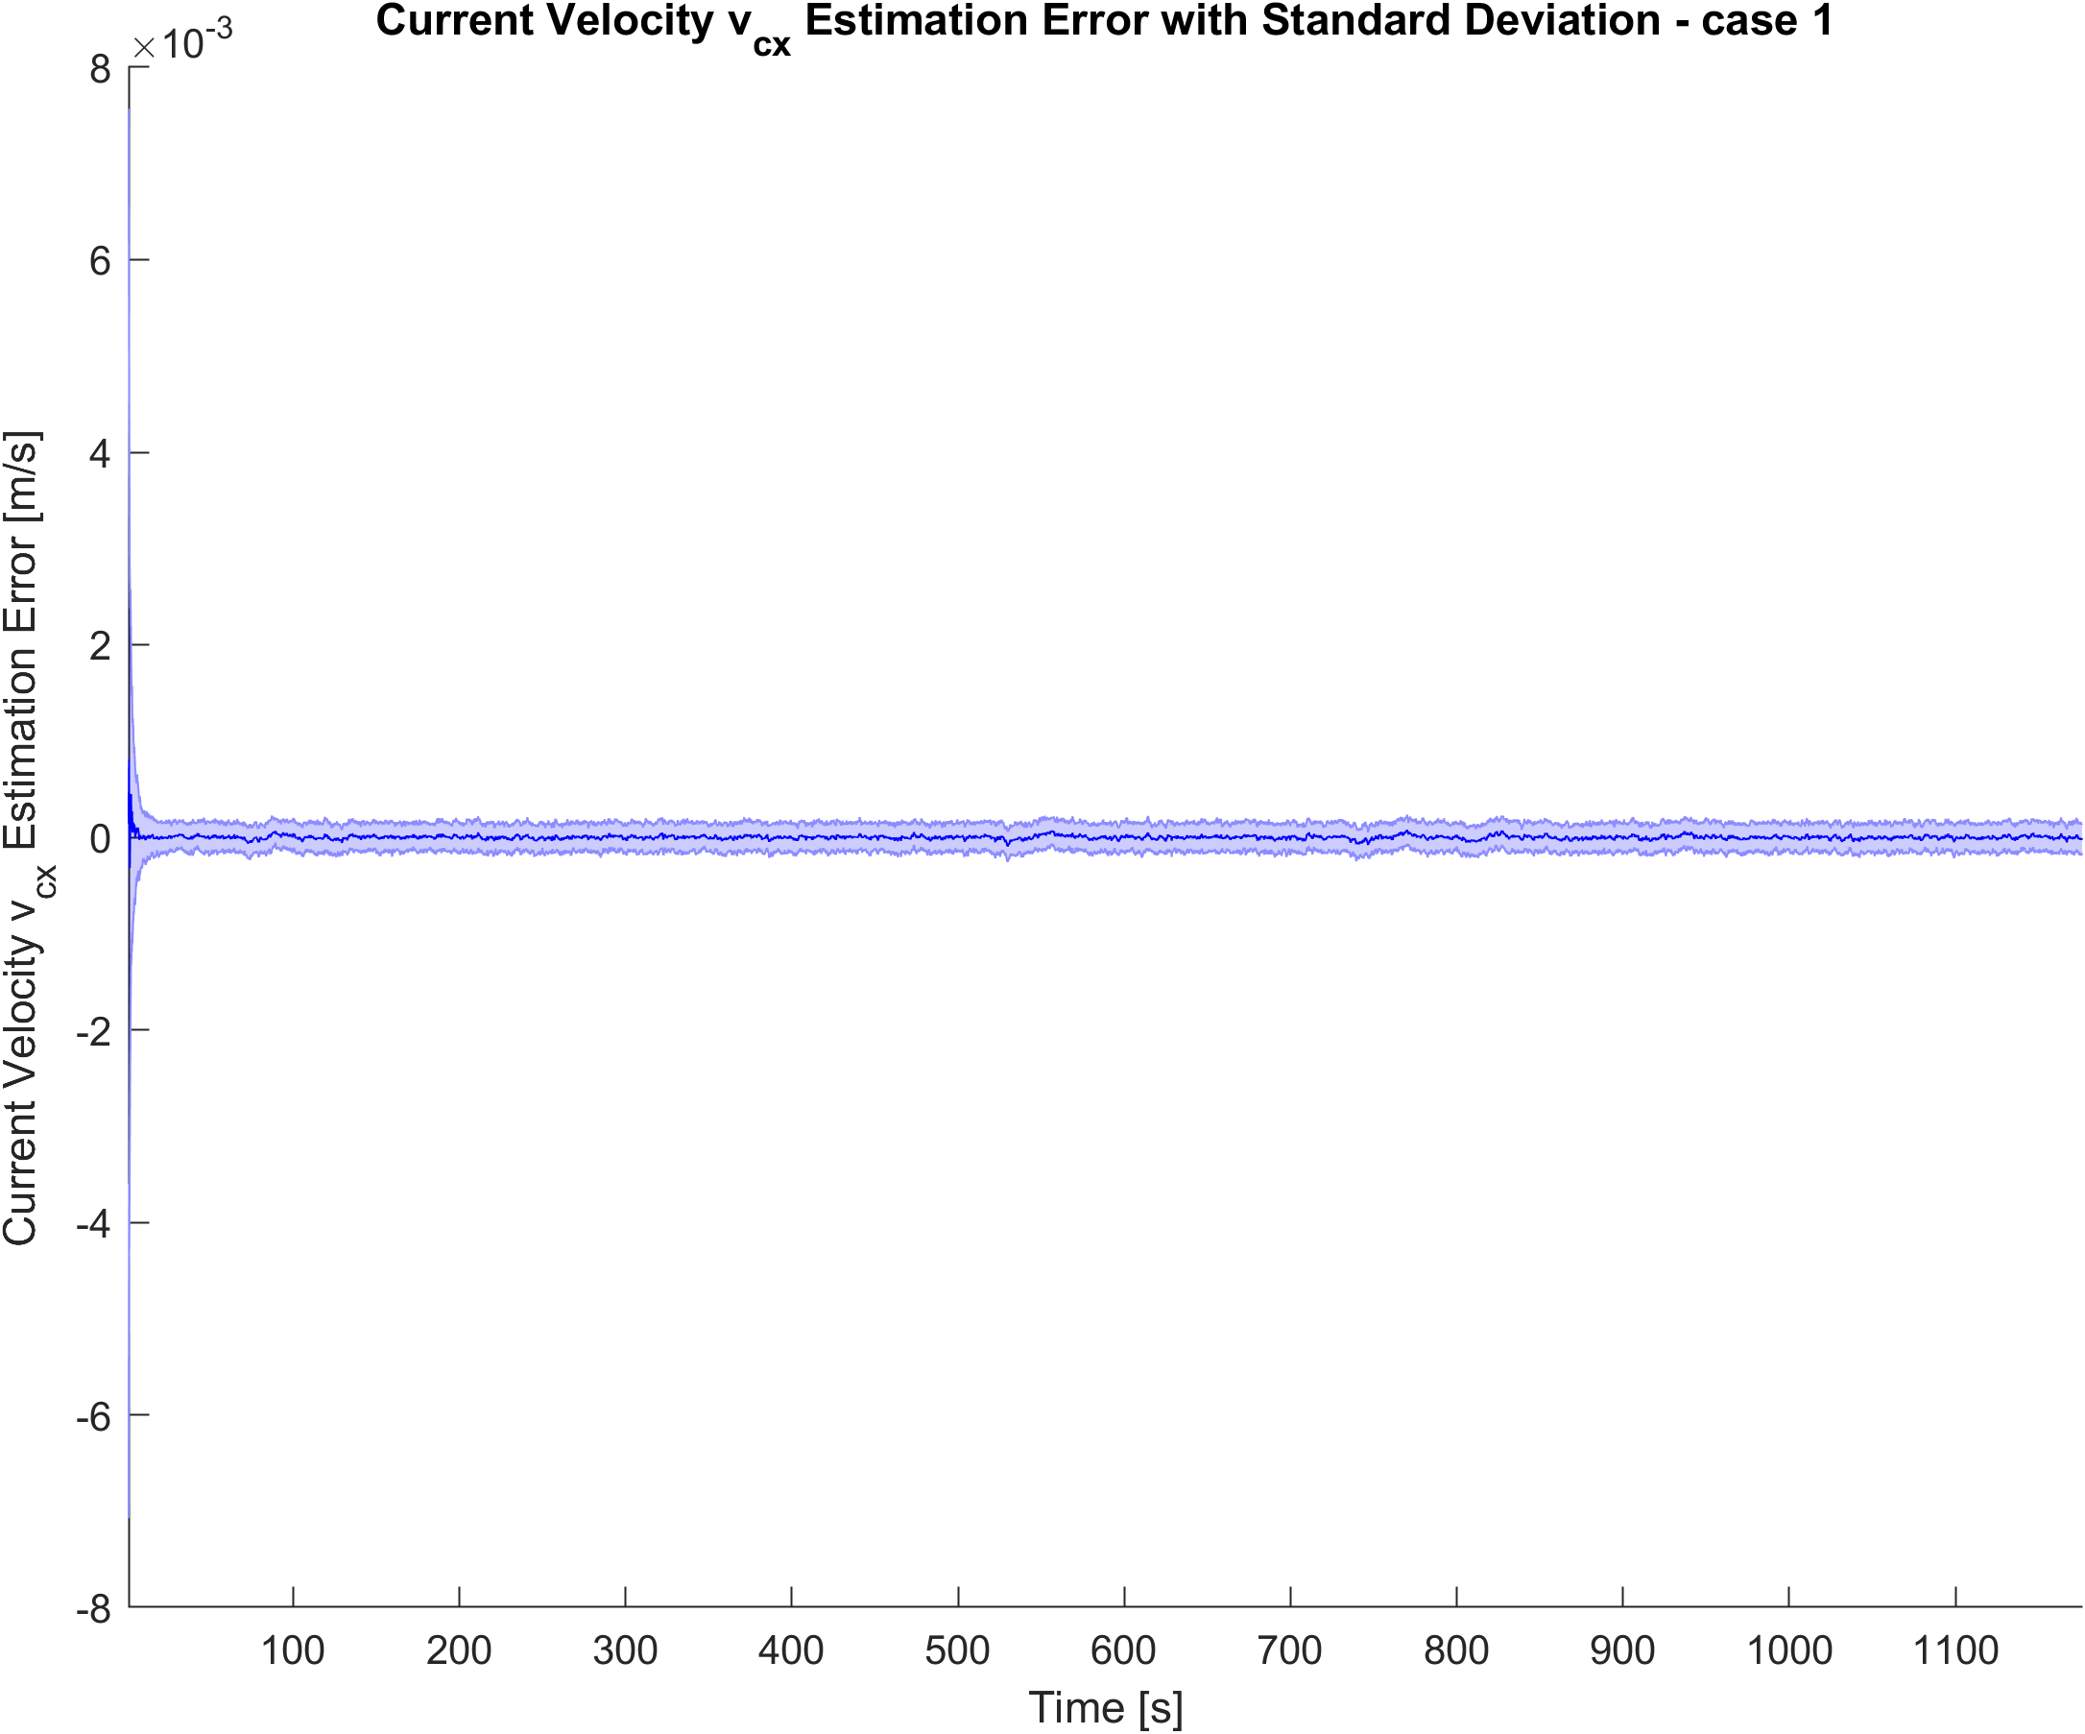
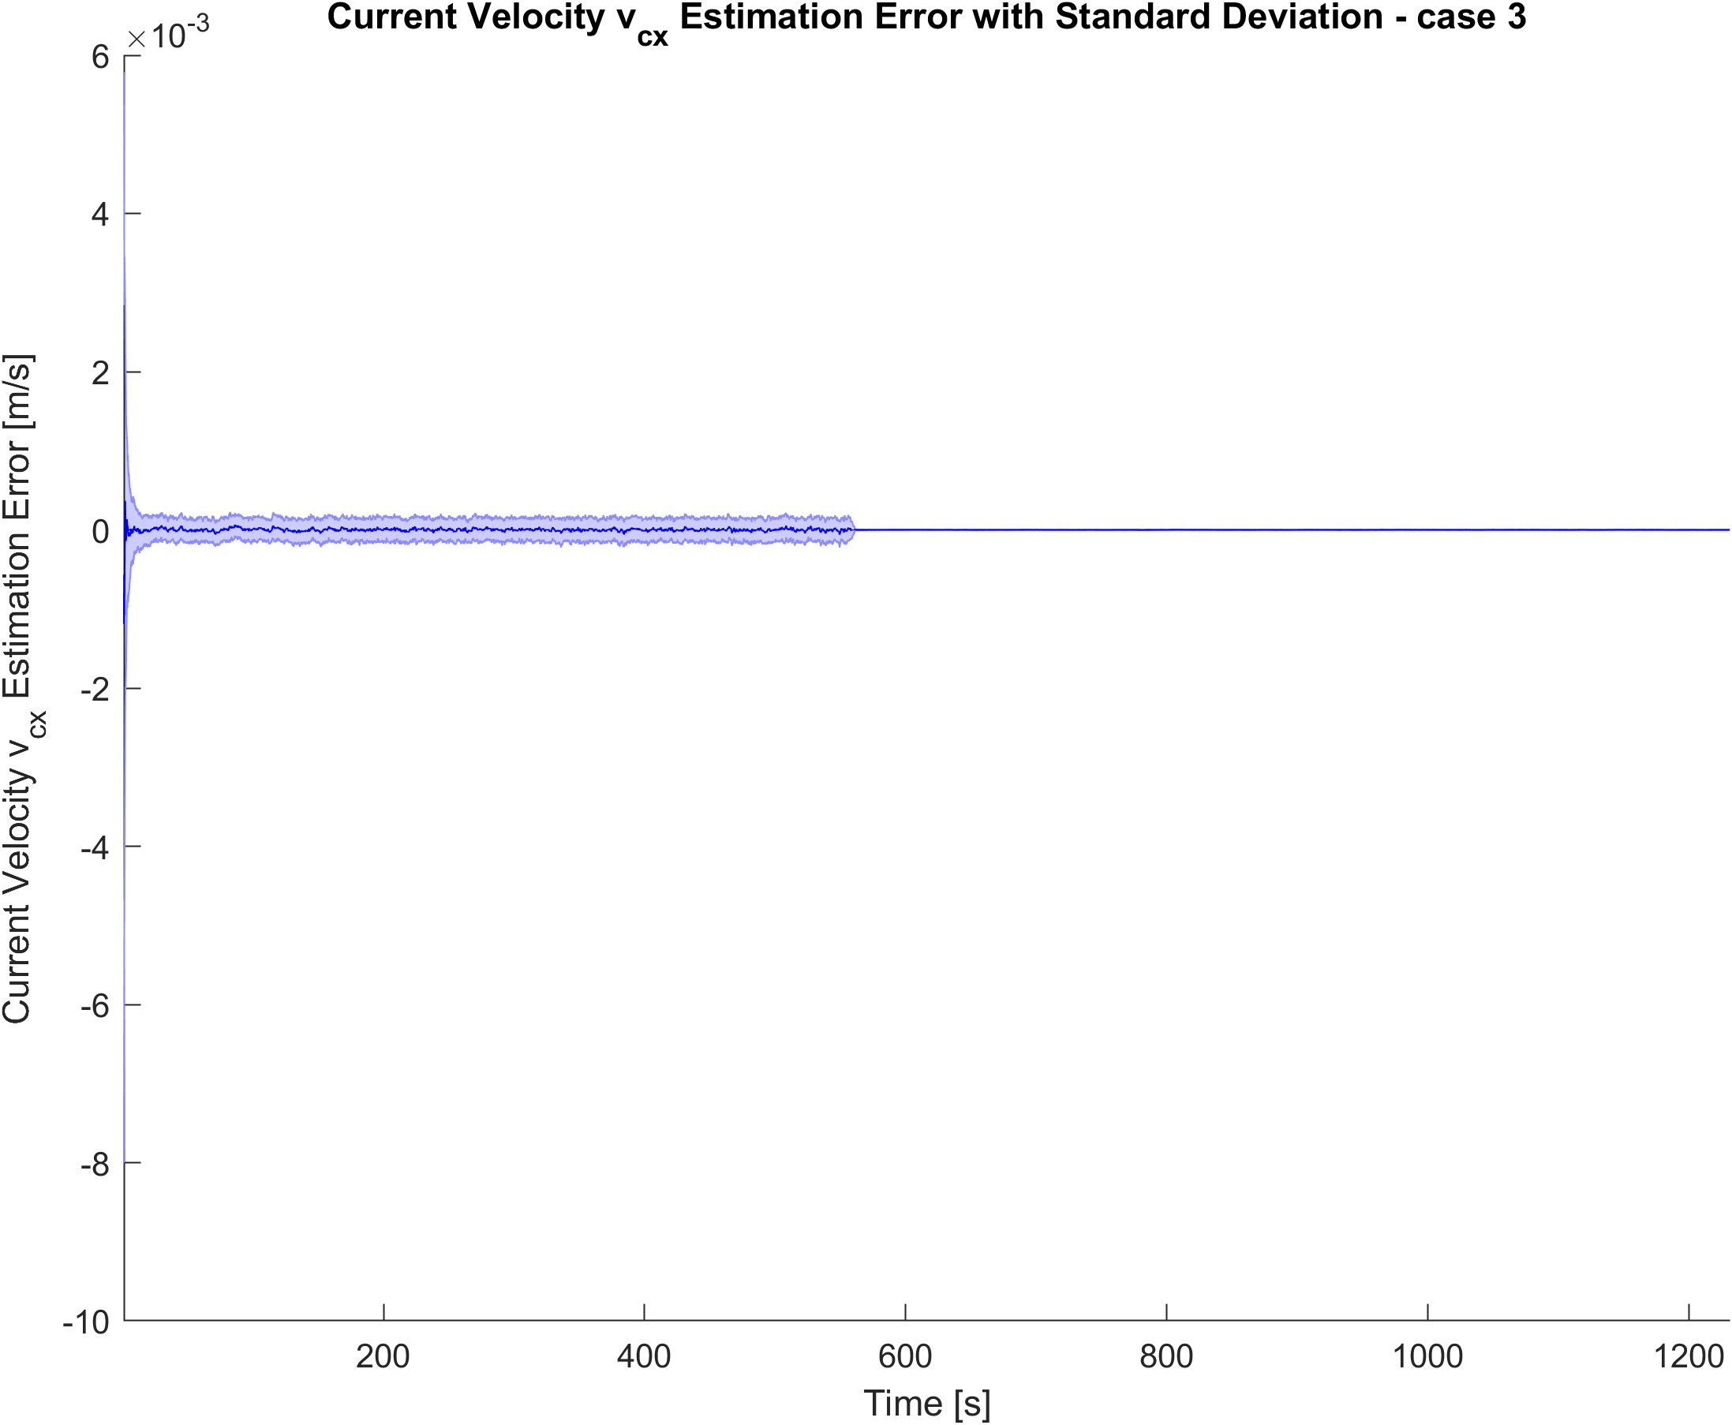



$v_{c_{x}}$ ESTIMATE ERROR
CASE STUDY 1
CASE STUDY 3

Slide 22

4 CASE STUDIES - RECALL
CASE STUDY | CONTROL LAW | DS KNOWLEDGE | REAL vs (E)KF NOISE STANDARD DEVIATION
1 | 1 | $P_{DS}$ known $ψ_{DS}$ unknown | 3x
2 | 1 | $P_{DS}$ unknown $ψ_{DS}$ known | 2x
3 | 1 | $P_{DS}$ and $ψ_{DS}$ unknown | 2x
4 | 2 | $P_{DS}$ unknown $ψ_{DS}$ known | 2x
Notes:
Would’ve been more fair to use the same amount of noise for a proper comparison
I expect a better behavior with even noise settings -> Further test

Slide 23
CASE STUDY
# of DOCKINGS
1
93
DOCKING FREQUENCY
2
98
3
99
4
100
23
Notes:
CS 1 -> if i decrease the noise, i expect results to improve

Slide 24

Good performance in highly noisy conditions
Promising results for the $ψ_{r}$ estimation cases
CONCLUSION
Sliding Mode control
GNSS Data for global localization
FUTURE WORK
Notes:
SMC: make the system move on a surface (‘sliding surface’), designing the controllers properly. Once on the surface, it follows the desired dynamics. Robust against model uncertainties and disturbances.

Slide 25

THANK YOU FOR YOUR ATTENTION
25

Slide 26



$u$ CONTROL ERROR
CASE STUDY 2
CASE STUDY 3

Slide 27



$v$ CONTROL ERROR
CASE STUDY 1
CASE STUDY 3

Slide 28

DYNAMIC MODEL
T. I. FOSSEN, Handbook of Marine Craft Hydrodynamics and Motion Control.
John Wiley & Sons, 2011
$$M_{RB}\dot{ν}+C_{RB}\left(ν\right)ν=τ_{RB}$$
With
$$τ_{RB}=τ+τ_{A}+τ_{D}+τ_{R}+τ_{dist}$$

